Slide 1

Power system management
Presented By: Muhammad Ghazali bin Ramly

Slide 2
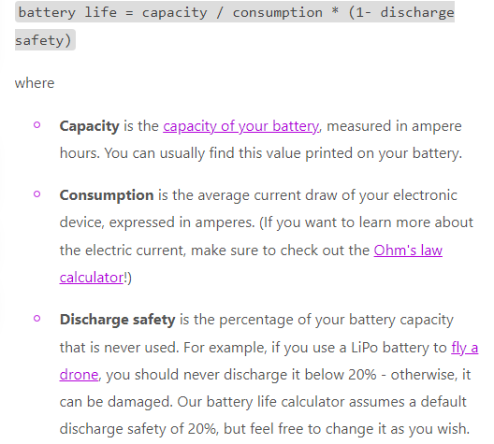
How to calculate battery runtime

Slide 3
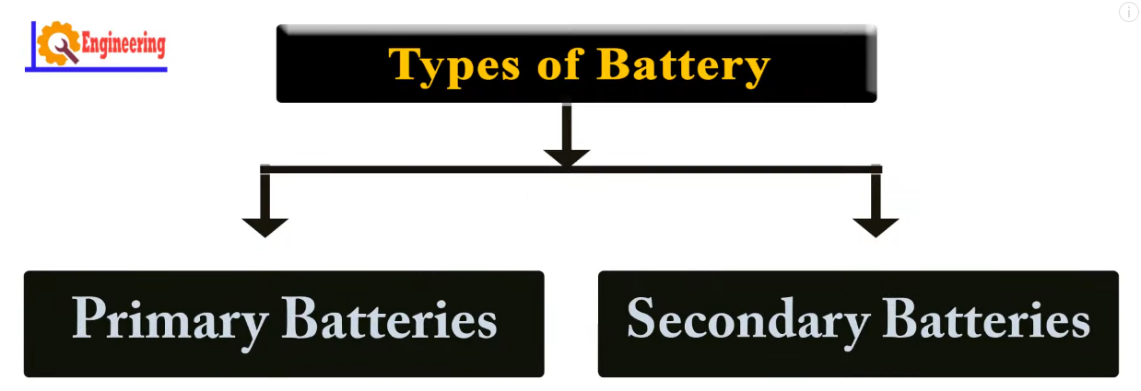

Slide 4
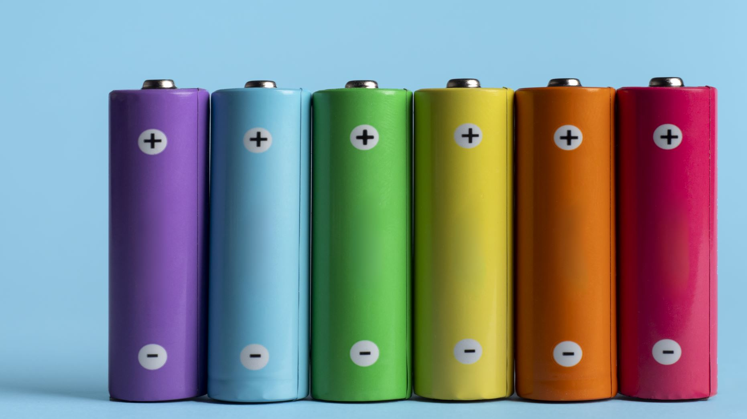
Primary battery
Primary batteries are single-use galvanic cells that store electricity for convenient usage, usually showing a good shelf life.
After use, primary batteries are discarded or, if legally (environmentally) required or for material cost-saving reasons, chemically reprocessed.
Primary batteries are found in many common consumer products such as remote-control garage door openers, remote automobile door locks, home smoke detectors, and remote controls for consumer electronic products such as television and stereo sets.

Slide 5
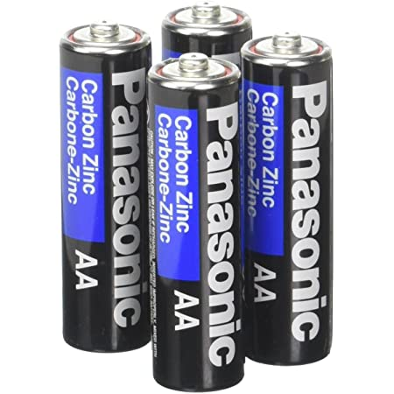
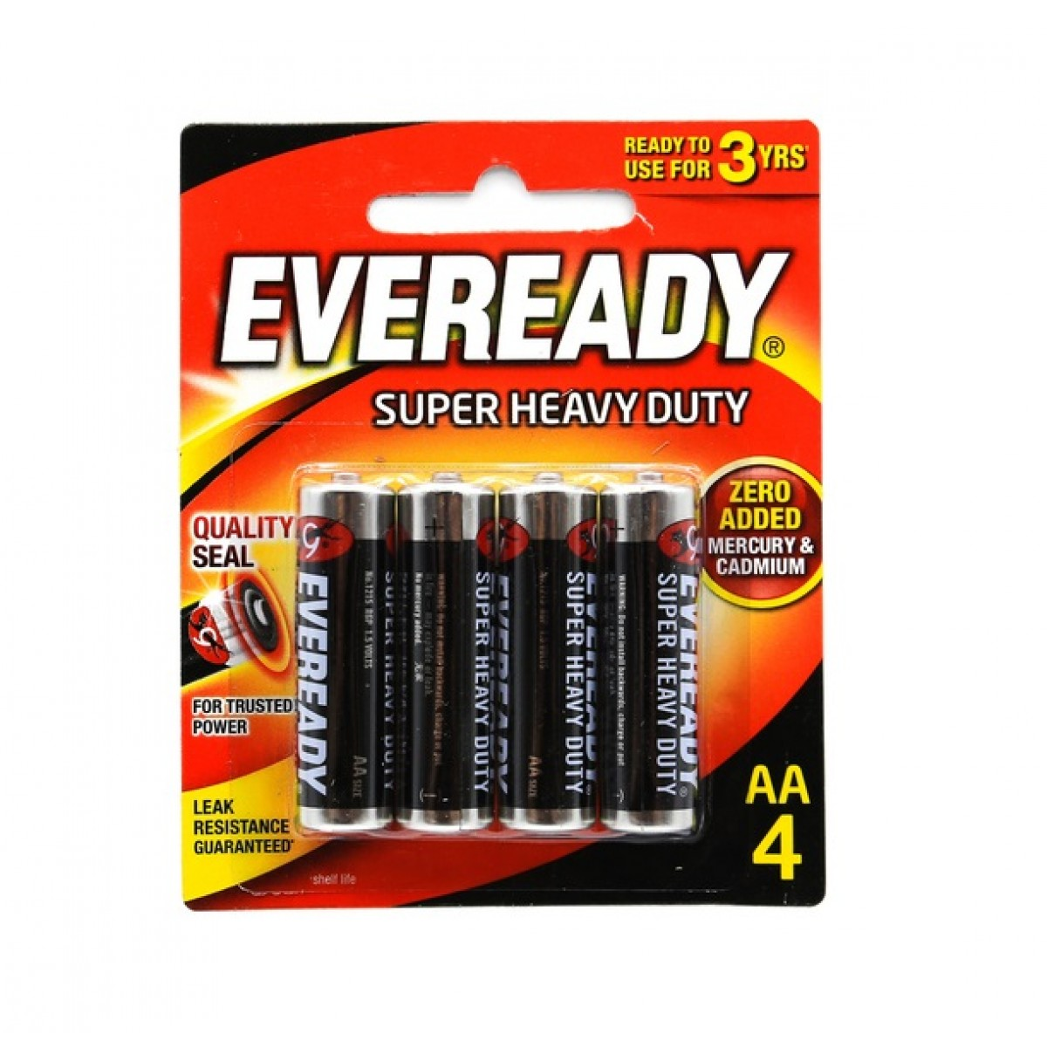
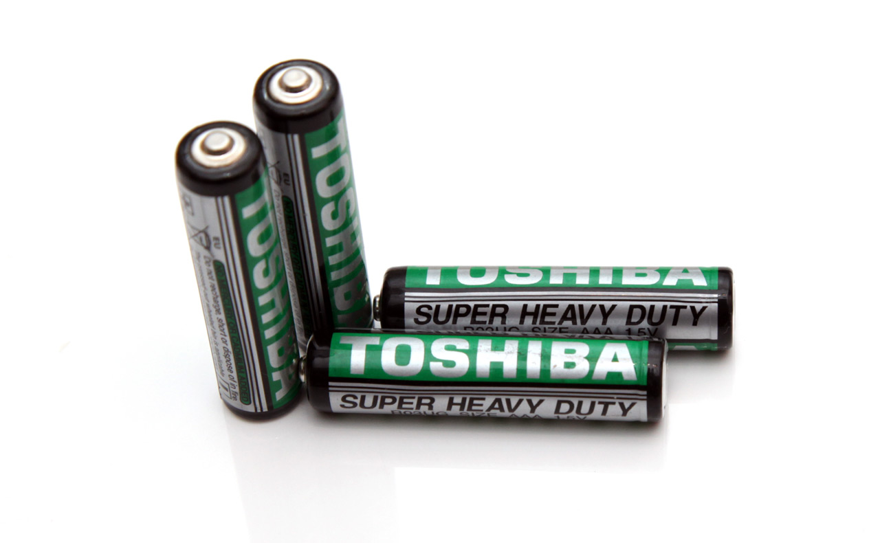
Carbon zinc (Heavy duty)
Carbon zinc batteries are extremely inexpensive but have a very low energy density.
Oftentimes, these batteries won’t be able to supply enough power to a high-drain device beyond merely turning it on.

Slide 6
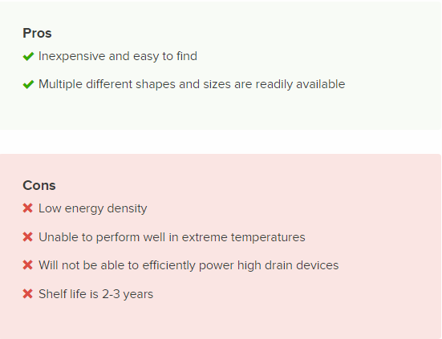
Pros and cons for carbon zinc battery

Slide 7
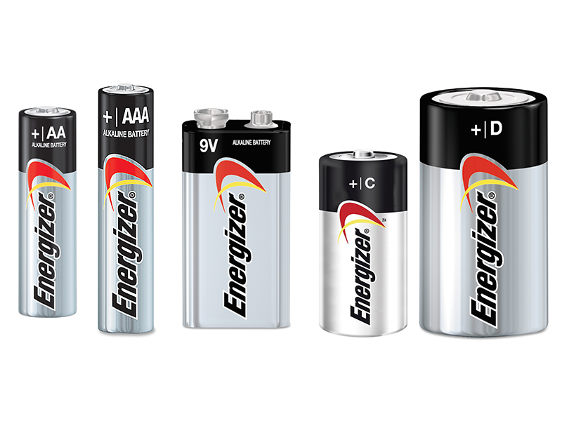
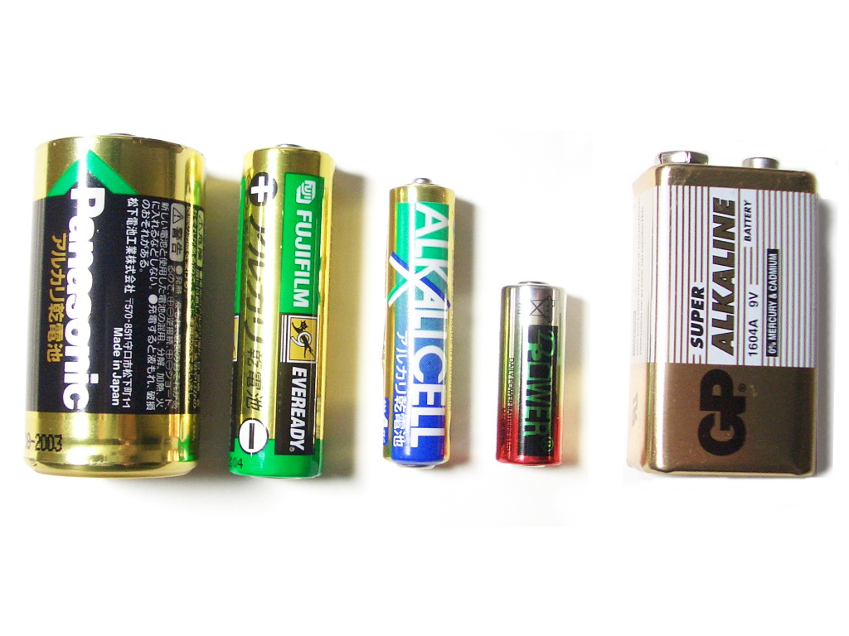
Alkaline cell
Alkaline batteries are economical, easy to dispose of, and extremely popular.
They normally have a capacity rating of over 2,500 mAh, great for moderate to heavy-use devices.
Unlike lithium batteries, almost every standard size battery offers an alkaline construction, making it perfect for most devices.

Slide 8
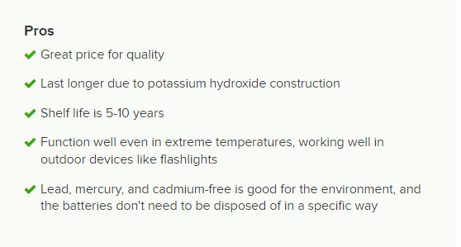

Pros and cons for alkaline cell

Slide 9
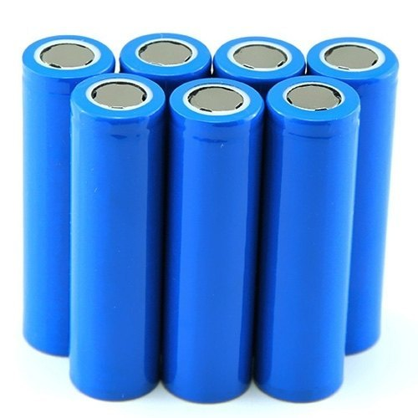
Lithium cells
Lithium batteries are one of the most commonly used battery types.
They offer the highest energy density of any other battery cell, meaning they store more energy than other batteries, such as alkaline.
Lithium batteries are only sold in AA, AAA, and 9V sizes; however, their mAh ratings exceed every other non-rechargeable battery.
One AA lithium battery ranges from 2,700-3,400 mAh, and will last a long time, even under heavy-use.

Slide 10
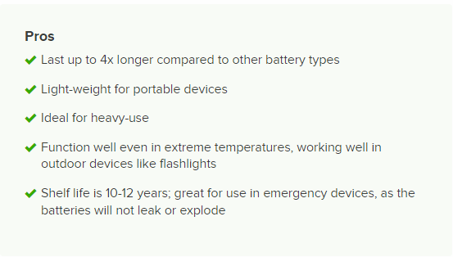
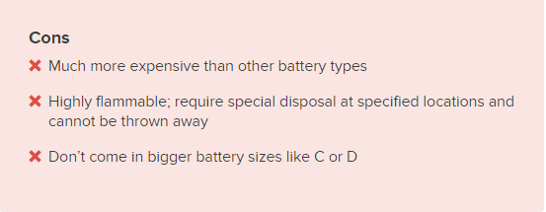
Pros and cons for lithium cells

Slide 11
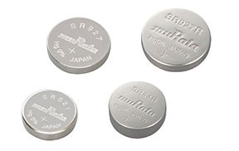
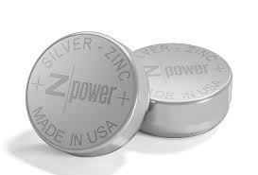
Silver oxide cells
Silver oxide batteries are commonly used in wrist watches and other small devices.
Because the battery is constructed of real silver, it is often sold only in button cells where the amount of silver is insignificant to the overall cost of the product.

Slide 12
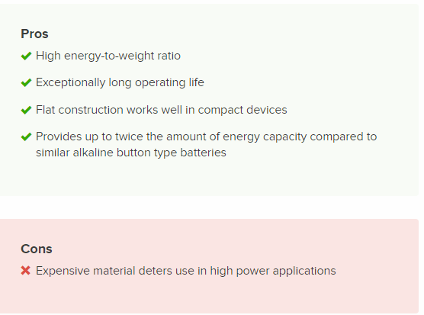
Pros and cons for silver oxide cells

Slide 13
Zinc air cells
Zinc air batteries are unique in their construction, as they generate electrical power through exposure to oxygen.
This makes them unfit for wrist watches, but perfect for hearing aids.
Activating the battery requires a user to remove a sealing tab from the battery, enabling airflow.

Slide 14
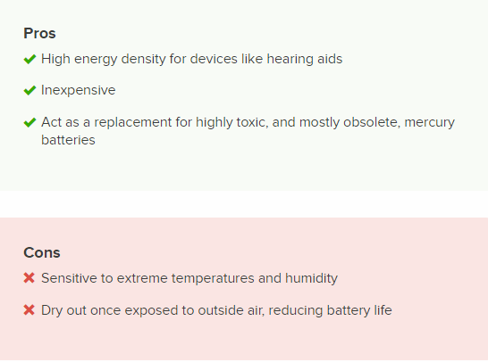
Pros and cons for zinc air cells

Slide 15
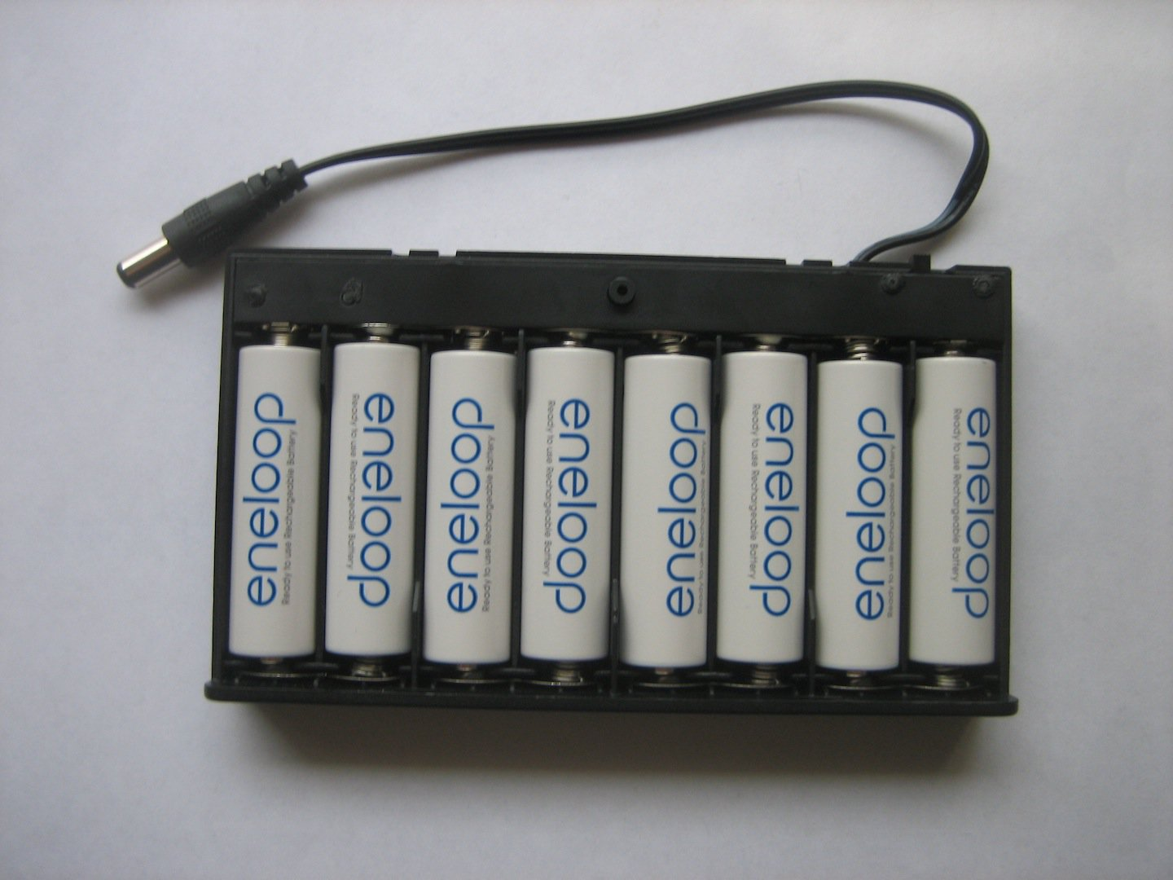
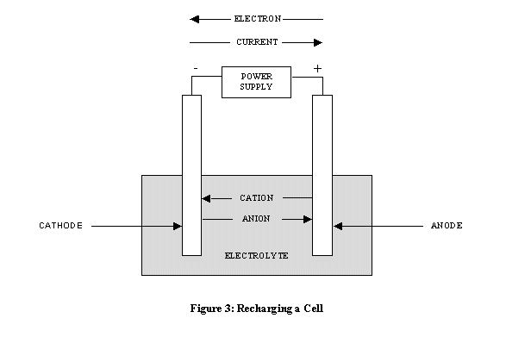
Secondary battery
A secondary cell or battery is one that can be electrically recharged after use to their original pre-discharge condition, by passing current through the circuit in the opposite direction to the current during discharge. The following graphic evidences the recharging process.
Secondary batteries fall into two sub-categories depending on their intended applications.
Cells that are utilized as energy storage devices, delivering energy on demand. Such cells are typically connected to primary power sources so as to be fully charged on demand. Examples of these type of secondary cells include emergency no-fail and standby power sources, aircraft systems and stationary energy storage systems for load-leveling.
Cells that are essentially utilized as primary cells but are recharged after use rather than being discarded. Examples of these types of secondary cells primarily include portable consumer electronics and electric vehicles.

Slide 16
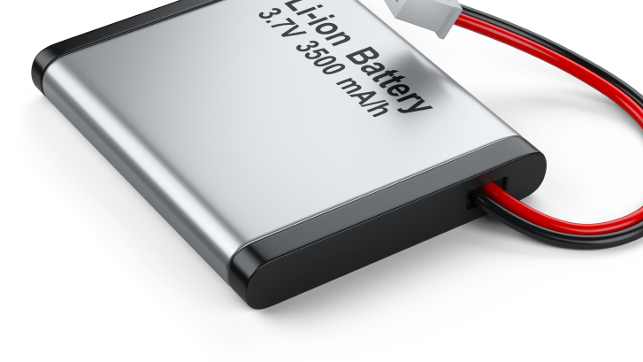
Lithium Ion battery
Lithium-ion batteries, also frequently referred to as li-ion, are the most popular and regularly used batteries in today’s world.
Although you may not realize what kind of battery powers your cell phone or laptop, chances are it’s a li-ion battery. These batteries are a type of rechargeable battery and can be recharged repeatedly.
They do not require regular maintenance and provide an extremely high energy density. Li-ion batteries are not available in consumer sizes because they could explode if placed in a regular device used to recharge batteries. Instead, they require a special kind of charger with a specific lithium-ion charge algorithm.

Slide 17
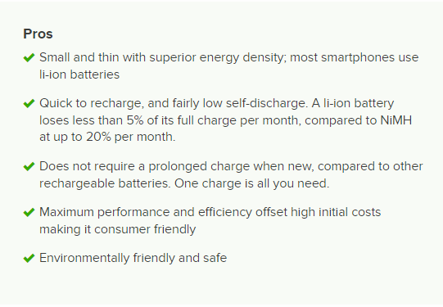
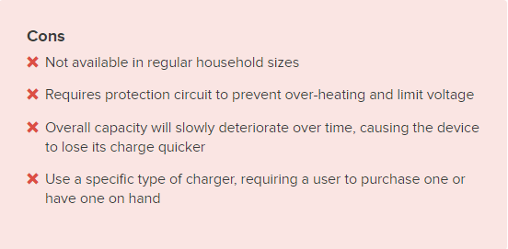
Pros and cons for lithium ion battery

Slide 18
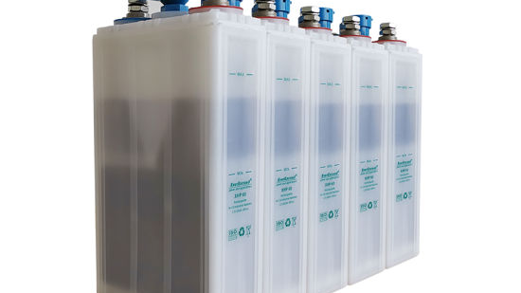
Nickel-cadmium battery
NiCd batteries, or nickel cadmium, are a popular choice for toys, digital cameras, or other high-drain devices like flashlights. They come in standard sizes, like AA, AAA, C, and 9V.
NiCd batteries are unique compared to other batteries, such as alkaline, in that they will maintain a steady voltage up until the battery is depleted.
With 1.2V per cell, it does not have a high voltage, but the powerful delivery makes up for this.
For example, you can tell when a flashlight is dying, as the lightbulb will slowly dim. With NiCd batteries, the brightness will remain constant, until the battery’s power is depleted.

Slide 19
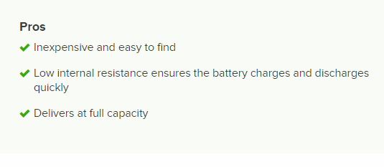
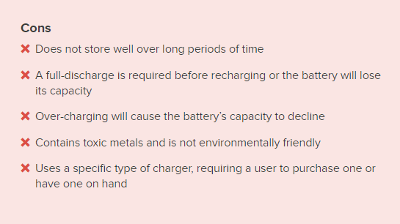
Pros and cons for nickel-cadmium battery

Slide 20
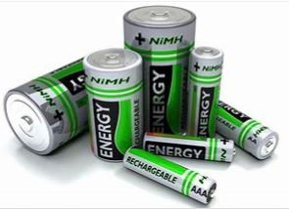
Nickel-metal hydride battery
Although NiMH batteries are labeled as high-density, this can come at the expense of a reduced cycle life.
They have a high energy density but can only be recharged about 500 times.
While they will certainly pay for themselves over time, they may not be the best choice for applications like smoke alarms, TV remotes, or clocks.
All these devices draw very low energy, and a NiMH battery is best used within a 30-day period. Like NiCd batteries, NiMH batteries will deliver at full capacity until almost all the energy has been discharged.

Slide 21
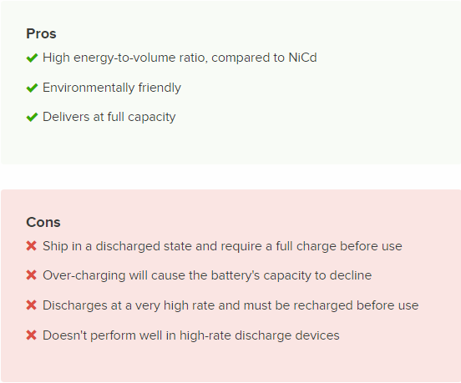
Pros and cons for nickel-metal hydride

Slide 22
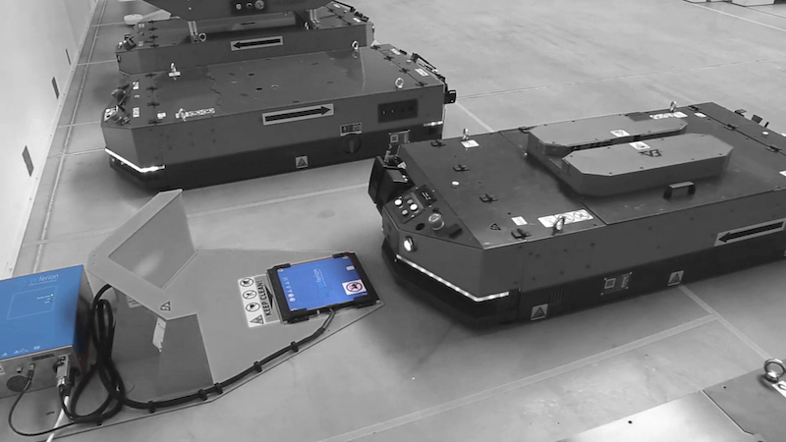
What is agv wireless charging?
With an inductive wireless charging system AGVs and AMRs can perform contactless battery opportunity charging.
The system counts on a stationary active fixed coil on the floor on on a wall and on a mobile passive coil on the mobile robot.
The active coil generates a magnetic field that induces an alternated current in the mobile coil. This current is used to charge the mobile robot battery.

Slide 23
Opportunity charging and battery swap strategy
What is opportunity charging?
What is battery swap strategy?
Opportunity charging, for mobile robots, permits batteries to be charged several times during its working hours. The autonomous mobile robot or AGV goes to defined charging stations and performs charging while waiting for a new mission to be delivered. If the battery balance is properly calculated, the vehicle could never need a change of battery.
Well, it’s pretty simple. The mobile robot works with a single battery until it is fully drained that need to be swapped with a fully charged one. Battery swapping can be done manually or automatically as needed or on a schedule.

Slide 24
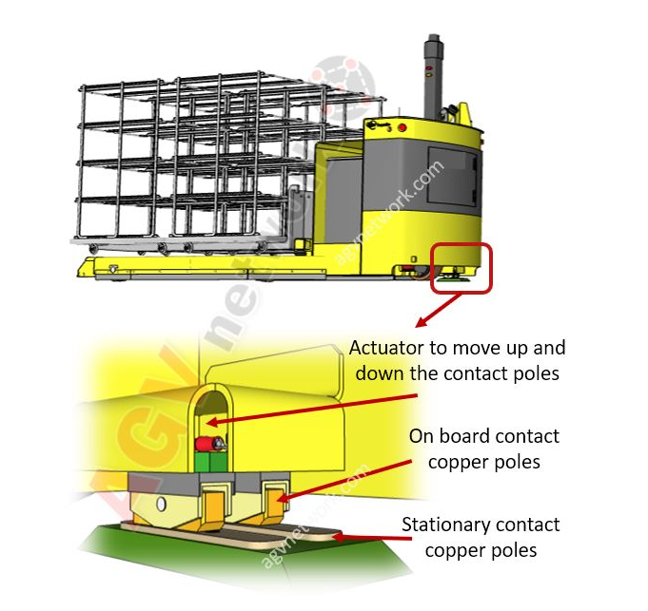
How does Wireless Charging for AMR and AGV work?
In the “contact” charging there’s is a physical connection between the charging poles.

Slide 25
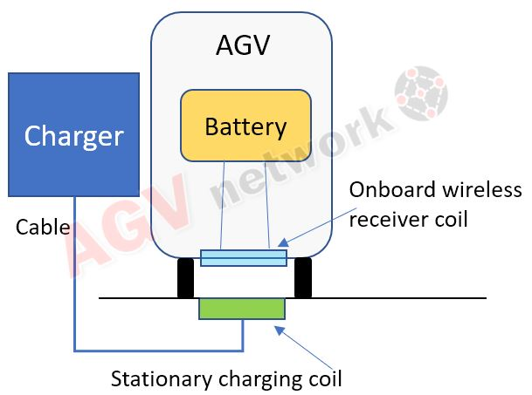
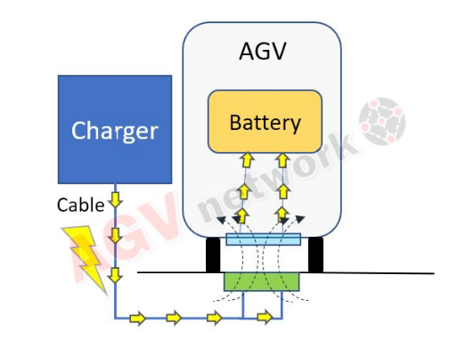
In the “wireless” charging the power transfer is done without any physical contact
The AGV with the onboard charging "coil" arrives to the charging station. The charging station is composed by the "stationary coil" and the charger.

Slide 26
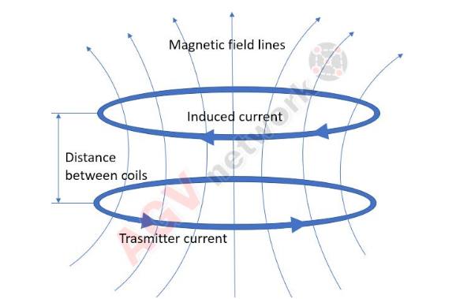
What is wireless inductive charging technology?
The concept of wireless charging is simple: a magnetic loop antenna (copper coil) is used to create an oscillating magnetic field, which can create a current in one or more receiver antennas (receiver coils).
The “induces” word opens the doors to the Inductive Power Transmission.

Slide 27
What are the advantages and disadvantages to Wireless Charging For AGV and AMR Robots?
ADVANTAGES
DISADVANTAGES
High Efficiency 93%-95%
Full Power Of High-Energy Streams Immediately After Start
No Wear And Tear Or Maintenance As There Are No Contacts Involved
High Mobile Robot Positioning Tolerance Compared To Contacts And Omnidirectional Charging
One single wireless charging system can supply power to different vehicles and batteries
Intelligent data transfer during wireless charging
Initial investment is relatively high compared to traditional contact opportunity charging.
They will have more time to accomplish missions
Maintenance cost
Cash flow is limited

